Slide 1
Workshop on Entrepreneuring for Engineers Institute of Engineers , Karachi 23rd September 2017
Azhar Rizvi,
CEO & Director
Cambridge Advisors Netwrok

Slide 2
How it all started ?
CAN - Broad based
Triple Helix
IBA – Invent, 3rd year
NUST PM Entrepreneurial Challenge, 4Year.
GISTECH
ICTRDF.
HEC - BPC for 150 Universities
HEJ Tech Park
Islamic Chambers of Commerce and Industry.
2006, 2007
MITEF – BAP : 8 years, 5 month process, EDP, Road shows.
Poster Child, 29 MITEF Chapters, Open opps

Slide 3
Entrepreneurial Culture
Culture, a broad word that one defines as "The collective programming of the mind which distinguishes the members of one human group from another.
Entrepreneurial Culture, in this sense, includes systems of values; and values are among the building blocks of entrepreneurial ecosystem.

Slide 4
What influences the development of entrepreneurial ecosystem ?
These factors are:
Economic condition of the nation
Education
Culture
Notes:
what influences the development of entrepreneurial activities. In these studies three major factors were recognized. These factors are Economic condition of the nation, Education, and Culture. If we were to consider these three factors we would find that Arabian nations are not short in either of the first two factors. These nations are among the richest in the world, with per Capita GDP's that places them near the top. Education is the other factor that these nations are catching up with. Many universities are being set-up in the region providing high quality education.

Slide 5
The 9 leading Arab economies (1980 and 2000)
High growth rate
Education
Steady development
Oil wealth
One would expect to have more entrepreneurs in the region.
Notes:
In an article published by Dr. Abonamah on January 29th, 2005 and appearing in e-entrepreneur he states that between the years of 1980 and 1999 only 370 patents were registered in the 9 leading Arab economies. If you were to compare the ratio of total population of these nations to the number of patents developed, the ratio will more than shock you! But why is it so, with such high growth rate and steady development, based on oil wealth, one would expect to have more entrepreneurs in the region.

Slide 6
370 patents were registered – 20 YEARS
Bell Labs - 27000 active patents

Slide 7
"Hofstede dimensions".
Study conducted on 100,000 employees
IBM
6 Distinct Factors – Explain behaviors in different Cultures.
Notes:
With this in mind, I was ready to analyze why GCC countries don't produce more per capita entrepreneurs. The answer to my question was found in a study conducted over 30 years ago by Geert Hofstede, a psychologist working for IBM. Hofstede, who surveyed more than 100,000 IBM employees scattered across the globe was able to identify 4 distinct factors that can help explain the behaviors existing in different cultures. He called them "dimensions" and they became known to us as "Hofstede dimensions". These 4 distinct factors are

Slide 8
Individualism vs. Collectivism
Masculinity vs. Femininity
High vs. low power distance
High vs. low uncertainty avoidance.
Long-term versus short-term orientation (LTO)
Indulgence versus Restraint (IVR)

Slide 9
Individualism vs. Collectivism:
This dimension measures the amount of emphasis a society places on "individual" achievement over "group" achievement.
The natural finding that Individualistic cultures tend to have more entrepreneurial activities comes as "no surprise".
Is this true that we in Pakistan rather emphasize group values over individual success.
Notes:
The natural finding that Individualistic cultures tend to have more entrepreneurial activities comes as "no surprise". In this category, the worlds greatest supplier of entrepreneurs, the United States, had the single highest score. On the other hand we had India and Mexico scoring 48 and 30 respectively. Relating it back to the Arab culture we can understand why such a factor would influence our drive towards success. Simply put we rather emphasize group values over individual success.

Slide 10
Masculinity vs. Femininity:
This dimension deals with gender/work relationships.
In masculine cultures, sex roles were sharply differentiated whereas in feminine cultures little distinction is made between males and females doing the same job. How does this affect our entrepreneurial activities? Simple, almost half the population is excluded from attempting any entrepreneur activities, thus sharply decreasing the number of possible female entrepreneurs.
Notes:
2. Masculinity vs. Femininity:
This dimension deals with gender/work relationships. In masculine cultures, sex roles were sharply differentiated whereas in feminine cultures little distinction is made between males and females doing the same job. Although both India and Mexico had scores somewhere in the middle range, suggesting that such distinction does not exist, I believe the Arab culture would have scored much higher. This is due in part to the traditional view that a female role is to be housewives and full time mothers. How does this affect entrepreneurial activities? Simple, almost half the population is excluded from attempting any entrepreneur activities, thus sharply decreasing the number of possible female entrepreneurs.

Slide 11
High vs. Low power distance:
This dimension deals with how a society deals with the people acceptance of others "right" to exert power over them, even harsh power. How does this dimension affect our entrepreneurial activities? Given how importance inequalities are, many of the people at the lower end of the pyramid find difficulties being accepted in the culture as the ones that have high chances of success. This most likely impacts their perception of their own worth or right to step out of role and be individualistic risking, in the process, being disapproved by other members of society

Slide 12
Uncertainty avoidance:
This is the most important dimension. Uncertainty avoidance deals with how members of different cultures deal with ambiguous situations. Higher scoring nations feel uncomfortable with ambiguous situations and vise versa.
How does this help explain the shortage of entrepreneurial activities in Pakistan? Risk is built into entrepreneurial activities. The fact that many people have to leave their secured jobs to start a new business makes it a risky venture living in our society. As such, it is not surprising to find that many in our part of the world choose the security and safety of a permanent job over the risks of starting a new business.
How to make us more risk taking ?
Notes:
4. Uncertainty avoidance:
Out of the four factors I believe this is the most important dimension. Uncertainty avoidance deals with how members of different cultures deal with ambiguous situations. Higher scoring nations feel uncomfortable with ambiguous situations and vise versa. How does Mexico hold up in this dimension? They had a score of 82. My assumption is that the Arabic culture will score at least as high if not higher than that. Arabs have a rich history of exploration, trade and multi-cultural experiences. How does this help explain the shortage of entrepreneurial activities? Risk is built into entrepreneurial activities. The fact that many people have to leave their secured jobs to start a new business makes it a risky venture living in modern society. As such, it is not surprising to find that many Arabs choose the security and safety of a permanent job over the risks of starting a new business. Although one can speculate back and forth and many exceptions and limitations to this particular theory maybe found, it still helps define the problem and shed some light on why it exists. Whether this trend would continue or not is still to be seen. Many of us have experienced a quantum leap in cultural values and practices over the last 20 year and what used to be a rule had in many cases become an exception. As such, I would not be surprised as more and more entrepreneurs start coming out of this region.

Slide 13
Long-term vs. short-term orientation (LTO)
The long-term orientation dimension can be interpreted as dealing with society’s search for virtue. In societies with a long-term orientation, people believe that truth depends very much on situation, context and time. They show an ability to adapt traditions to changed conditions, a strong propensity to save and invest, thriftiness, and perseverance in achieving results.
Societies with a short-term orientation generally have a strong concern with establishing the absolute Truth. They are normative in their thinking. They exhibit great respect for traditions, a relatively small propensity to save for the future, and a focus on achieving quick results.

Slide 14
Indulgence versus Restraint (IVR)
Indulgence stands for a society that allows relatively free gratification of basic and natural human drives related to enjoying life and having fun.
Restraint stands for a society that suppresses gratification of needs and regulates it by means of strict social norms.

Slide 15
Team Exercise
Prepare a 5 minute presentation addressing questions highlighted in the Presentation.

Slide 16
Why Prepare a Business Plan
To:
Test the feasibility of your idea.
Hire a great team!
Get the best/economical resources
Develop strategic alliances.
Secure funding / investment.
Prepare a long-term plan.

Slide 17
Typical R & D Project.
You identify a problem or a need.
Do literature research
You prepare a concept paper
Visit a few organizations/people for input.
Proposal / Project Plan
Funding: ICT R&D Fund, or Customer

Slide 18
R&D Phase
Establish product goals & attributes based on customer needs.
Identify components and parameters available for selection or adjustment.
Write the performance specs for the product.
Establish product configuration.
Select the components of the product
Optimize the parameters of the product.
Develop Prototype.

Slide 19
Typical R & D Project.
You identify a problem or a need.
You prepare a concept paper
Visit a few organizations/people for input.
Need analysis – Proposal / Project Plan
Funding – ICTRD or Customer
Prototyping – Beta Test
You make your first sale.
So what are the next steps ?

Slide 20
Next Steps
Try to sell it to customers.
Build a team
Get investment or Partners onboard.
Sales, Profits.
Expand your operations.

Slide 21
Next Steps
Let’s do a critical Analysis.
Try to sell it to customers.
Build a team
Get investment or Partners onboard.
Sales, Profits.
Expand your operations.

Slide 22
Entrepreneurial Approach.
A different Approach!
Problem or unmet need.
Market Size
Target Market
Opportunity Size
Solution: Product and/or Service
Product Testing.
Fine tune the product.
Commercialize the product.
Revenues – Profit – Losses etc.

Slide 23
Why Prepare a Business Plan
To:
Test the feasibility of your idea.
Hire a great team!
Get the best/economical resources
Develop strategic alliances.
Secure funding / investment.
Prepare a long-term plan.

Slide 24
Market
Market Size :
Number of buyers and sellers in a market.
Market Value:
Total exchange of money in the market.
Production.
Wholesale.
Retail.
Why is it so important ?

Slide 25
Market
It Answers Key Questions:
1. Where we are going with our product/service ?
2. How are we going to get there ?
3. Is the market big enough to interest us ?
4. Is there a long-term potential for our product/service.
5. Is the market profitable enough ?
6. Who are the main players ?

Slide 26
Market Segmentation – Target Market.
Geographic Segmentation ( Location)
Demographic Segmentation ( Age, income )
Psychographic Segmentation. (lifestyle – urban, rural, music lover )

Slide 27
Now you select the target market and calculate the opportunity Size.
Identify the problem, unmet need, you are going to solve. E.g.
New applications of existing technologies
Process innovation.
Improving supply chain.
Enhancing the life, value, applications of current product / service.
Paradigm shifting……………… !

Slide 28
R&D Phase
Establish product goals & attributes based on customer needs.
Identify components and parameters available for selection or adjustment.
Write the performance specs for the product.
Establish product configuration.
Select the components of the product
Optimize the parameters of the product.
Develop Prototype.

Slide 29
Competitive Analysis.
Product/Service
Top products/services
Product/Service Success Analysis
Product Weaknesses
New Products/Services
New Product/Service Success Analysis

Slide 30
Competitive Analysis ( Contd.)
2. Human Factor
Retention Rate
Employee Longevity
Service Quality
Market Penetration
Dissatisfaction Control

Slide 31
Competitive Analysis ( Contd.)
3. Financial Factor
Operating Profit Margin
Net Profit Margin
Return on Assets
Return on Equity
Cash Flow Growth vs. average Cash Flow Growth Within the Industry

Slide 32
Competitive Analysis ( Contd.)
4. Strategy and Tactics
Competitor Objectives
Company's objectives VS Competitor's objectives -growth rate, customer loyalty, market share, technology leadership, etc.) allows to foresee and predict its actions.
Responsiveness
Company's ability to react VS Competitors ability to react e.g. with large cash reserves you can act both defensively and offensively

Slide 33
Features

Slide 34
Go-to-market Strategy
Current Market Scenario can be characterized
as: hyper-competition, shortening lifecycles,
rapid commoditization and complex ecosystems
What to sell ?
Whom to Sell ?
How to Sell ?

Slide 35
Market Demand - what is driving or inhibiting market demand for your product segment?
Customers - what are customer needs, especially unmet needs, and what are their key buying factors?
Competition - what competitive set best represents competition and how are they competing?
Differentiation - what differentiators are sustainable & difficult to replicate by competitors?
Solutions - what solutions best meet market demand and customer needs?
Channels - what channel structure & programs enable reaching desired customer segments cost-effectively?

Slide 36
Business Model
Value proposition - value of the product from the customer's perspective.
Market segment
Value chain structure - the firm's position and
activities in the value chain
Revenue generation and margins
Competitive strategy - sustainable competitive
advantage

Slide 37
Business Model Examples
Bricks and clicks Model – Order online collect from store
Cutting out the middleman Model
Direct sales model
Franchise model
Freemium model – Free basic service charge for premium service
Etc.

Slide 38
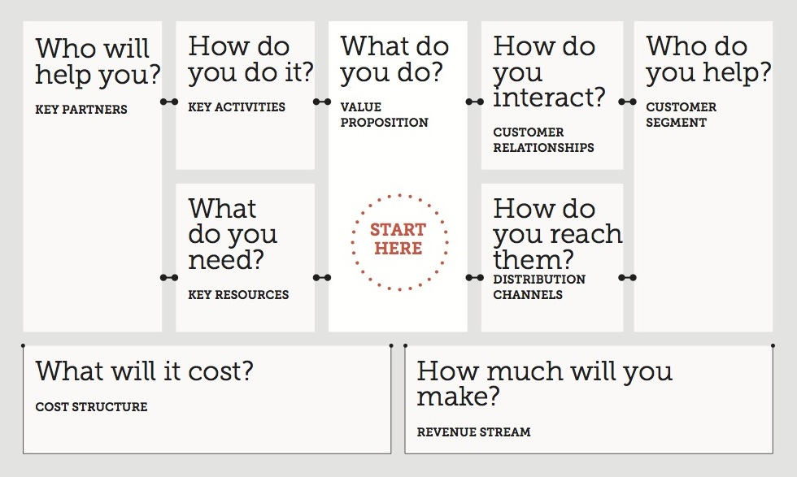

Slide 39
Financial Plan
Four Steps to build a financial plan:
1. Sales Forecast
- Time Frame – two or three years
- Assumptions about sales per customer, number of customers
and growth rate of sales
- Calculations of sales forecast.
2. Cost Forecast
- Assumptions about the cost of doing business in the specified
time frame .
- Calculations of the costs associated with the project sales of step 1.

Slide 40
Financial Plan ( Contd.)
3. Income and Cash flow forecast:
- Estimation of income and costs on the
monthly basis over the time (CFIMITYM)
4. Balance Sheet:
- Estimation of assets, liabilities and
shareholders' equity at a specific time.

Slide 41
Exit and Failure.
Failure :
Failing to achieve a positive cash flow as per your plan.
Set a time line and stick to it.
Learn from the failure and then consider a new venture.
Exit Strategy :
Plan it in advance
VC
Merger / Acquisition
IPO.

Slide 42
Case Study
We will focus on Pakistan’s population living below the poverty line:
Almost 100 Million
Wage earner 50 M
Disposal Income : Rs 1,000 M / Day
Unmet Needs
Education, Health Care, Food, Shelter, Jobs.

Slide 43
Case Study (Contd.)
Tata Tablet Rs 1,200/-
Education : Literacy
Health Care : Telemed
Jobs : Training and placement
Shelter : Low Cost housing
Food : Home Farming, Animal Farming through Micro financing.

Slide 44
Assignment.
Concept Paper on your project. ( 1 hour)
Prepare a five slide presentation ( 20 mins )
A three minute presentation tomorrow morning. ( 3 rehearsals )

Slide 45
Thank You and see you tomorrow InshaAllah.

